Slide 1

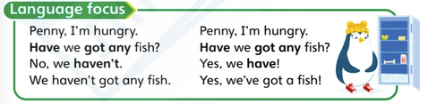
SuperMinds 2
Lunch Time
presentation
Have you got any...?

Slide 2
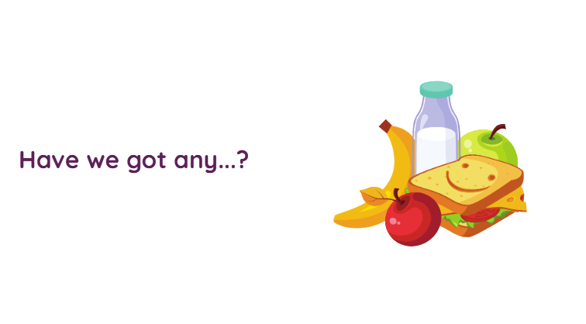

Slide 3
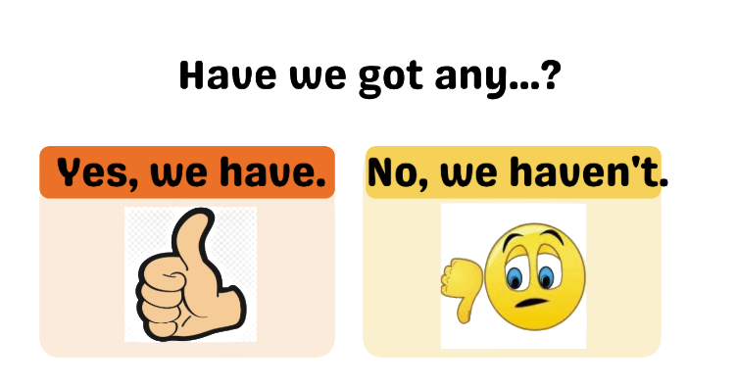

Slide 4
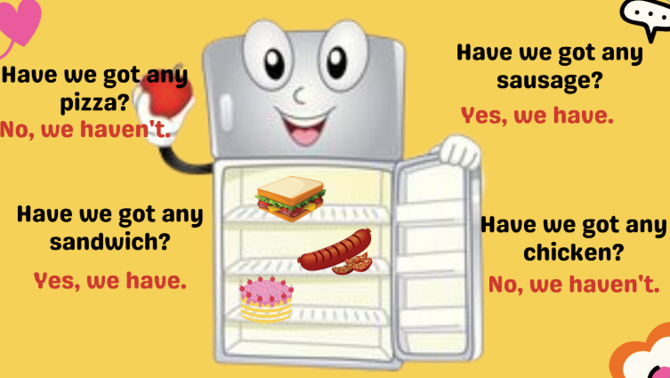

Slide 5
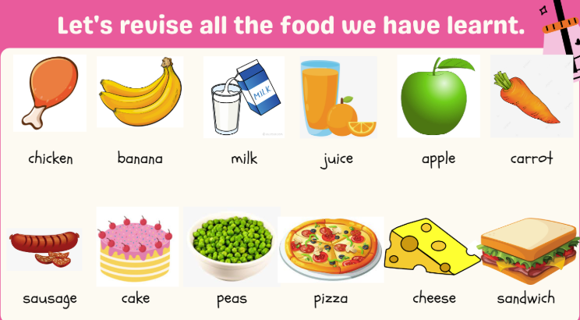
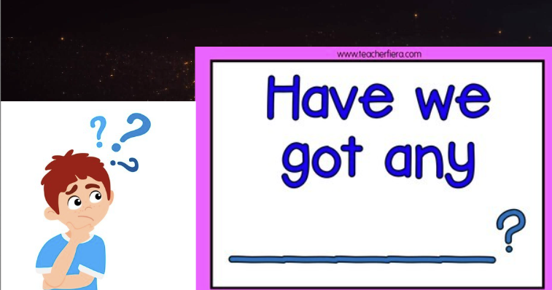
Задай запитання до кожної картинки
наприклад:
У тебе є курка?
Have you got any chicken?
Будова запитання “?”
Have you got any....?

Slide 6
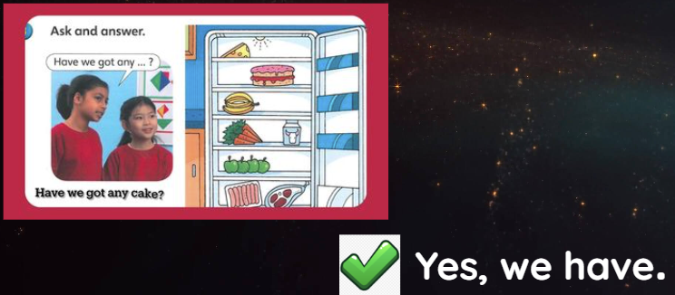
так
Ні

Slide 7
Як ми скажемо “так, ми маємо”
Yes, we have got....!
Have we got any fish?
Have we got any cake?
Yes, we have got a fish!
Yes, we ________ a _____!
Have we got any carrot?
Have we got any cheese?
Yes, ____ have ___ a ______!
_____________________!

Slide 8
Як ми скажемо “ні, ми не маємо”
Haven`t got - не маємо
Have we got any fish?
Have we got any cake?
No, we haven`t got a fish!
No, we ________ a _____!
Have we got any carrot?
Have we got any cheese?
No, ____ haven`t ___ a ______!
_____________________!

Slide 9
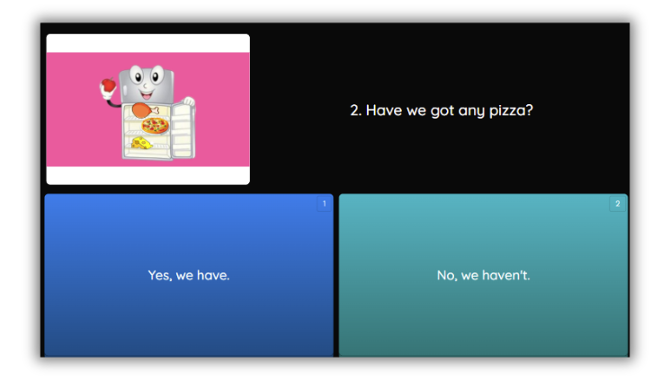

Slide 10
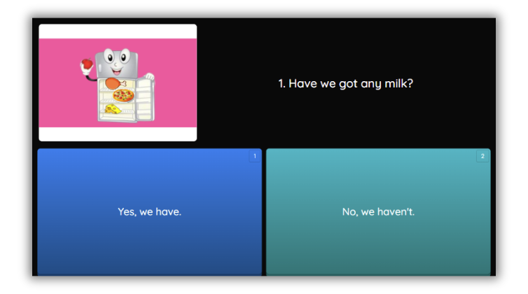

Slide 11
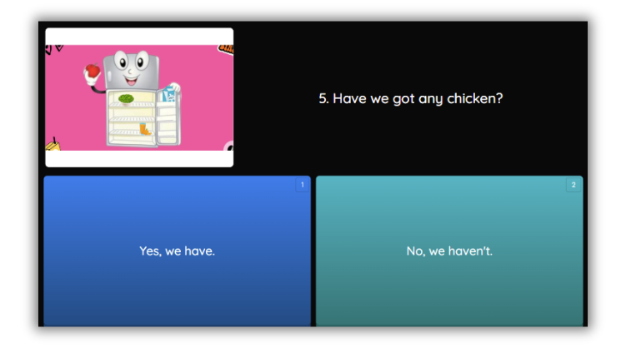

Slide 12
